Slide 1
User Interface Design
Module 4
CHAPTER 11 USER INTERFACE DESIGN
Roger S Pressman
Page 313 -

Slide 2
What is User interface?
The user interface is the front-end application view to which the user interacts to use the software. (If a product is to be successful, it must exhibit good usability)
User interface design creates an effective communication medium between a human and a computer. Following a set of interface design principles, design identifies interface objects and actions and then creates a screen layout that forms the basis for a user interface prototype.

Slide 3
Types of User Interface
Command Line Interface: The Command Line Interface provides a command prompt, where the user types the command and feeds it to the system. The user needs to remember the syntax of the command and its use.
Graphical User Interface: Graphical User Interface provides a simple interactive interface to interact with the system. GUI can be a combination of both hardware and software. Using GUI, the user interprets the software.

Slide 4
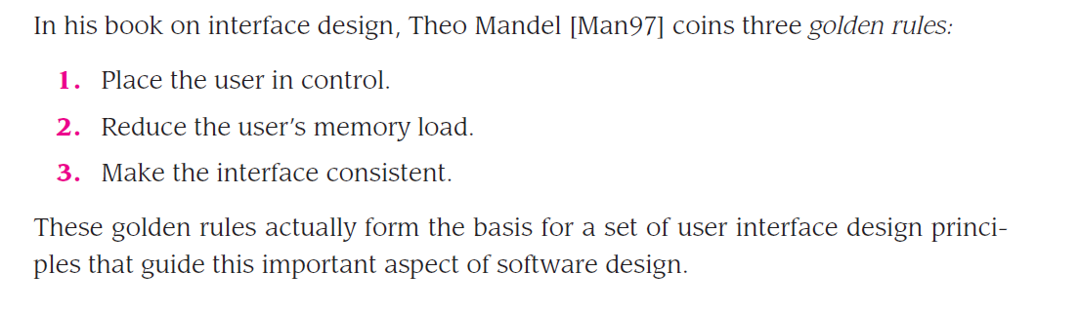
Principles of user interface design: 3 golden rule

Slide 5
1. Place the User in Control
Define interaction modes in a way that does not force a user into unnecessary or undesired actions.
Provide for flexible interaction. Because different users have different interaction preferences, choices should be provided.
Allow user interaction to be interruptible and undoable (without losing the work that had been done).
Hide technical internals from the casual user.
Design for direct interaction with objects that appear on the screen: For example, an application interface that allows a user to “stretch” an object (scale it in size) is an implementation of direct manipulation

Slide 6
2. Reduce the User’s Memory Load
Reduce demand on short-term memory. When users are involved in complex tasks, the demand on short-term memory can be significant. The interface should be designed to reduce the requirement to remember past actions, inputs, and results
Establish meaningful defaults. a “reset” option should be available, enabling the redefinition of original default values.
Define shortcuts that are intuitive. When mnemonics are used to accomplish a system function (e.g., alt-P to invoke the print function), the mnemonic should be tied to the action in a way that is easy to remember
The visual layout of the interface should be based on a real-world metaphor. For example, a bill payment system should use a checkbook and check register metaphor to guide the user through the bill paying process.
Disclose information in a progressive fashion. The interface should be organized hierarchically. That is, information about a task, an object, or some behavior should be presented first at a high level of abstraction. More detail should be presented after the user indicates interest with a mouse pick

Slide 7
3. Make the Interface Consistent
The interface should present and acquire information in a consistent fashion. This implies that all visual information is organized according to design rules that are maintained throughout all screen displays

Slide 8
Interface Analysis and Design Models
the user interface analysis and design process begins at the interior of the spiral and encompasses four distinct framework activities: (1) interface analysis and modeling, (2) interface design, (3) interface construction, and (4) interface validation.

Slide 9
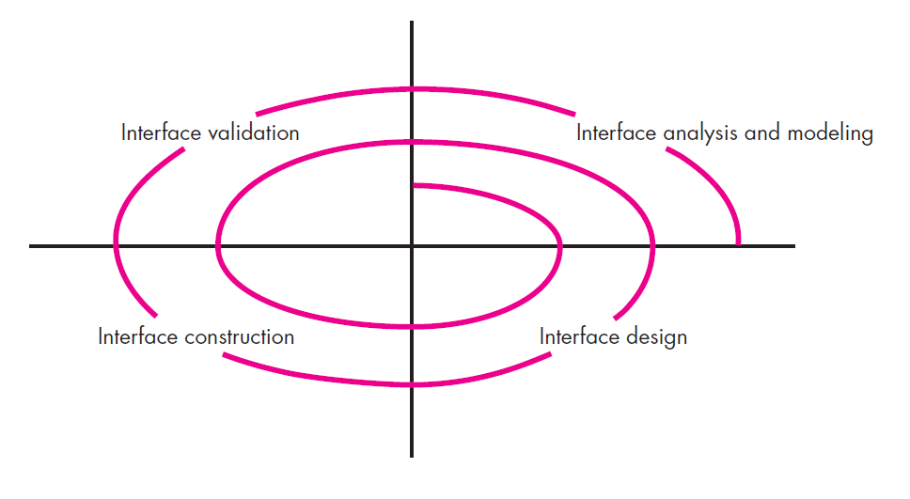
The user interface design process
The spiral shown, implies that each of these tasks will occur more than once, with each pass around the spiral representing additional elaboration of requirements and the resultant design

Slide 10
Interface Design Principles and Guidelines of Web Apps
Anticipation. A WebApp should be designed so that it anticipates the user’s next move
Communication. The interface should communicate the status of any activity initiated by the user
Consistency. The use of navigation controls, menus, icons, and aesthetics (e.g., color, shape, layout) should be consistent throughout the WebApp
Efficiency. The design of the WebApp and its interface should optimize the user’s work efficiency, not the efficiency of the developer who designs and builds it or the client-server environment that executes it.
Flexibility. The interface should be flexible enough to enable some users to accomplish tasks directly and others to explore the WebApp in a somewhat random fashion
Focus. The WebApp interface (and the content it presents) should stay focused on the user task(s) at hand
Latency reduction.
Learnability
Visible navigation

Slide 11
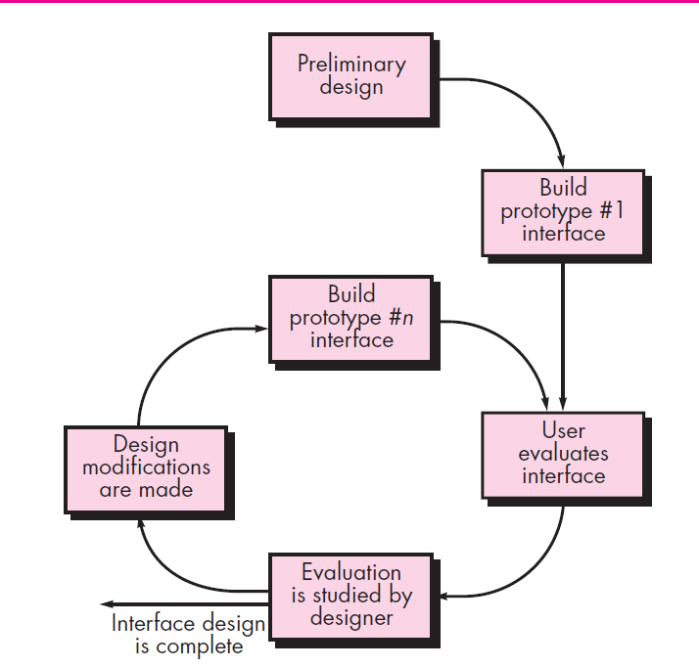
The interface design evaluation cycle

